Slide 1
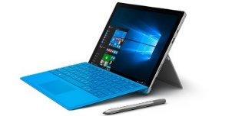
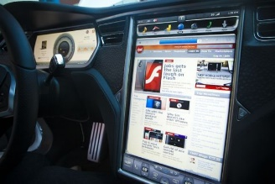

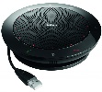




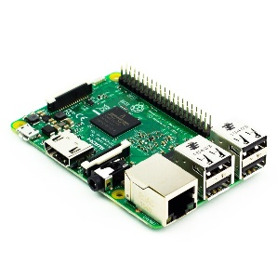

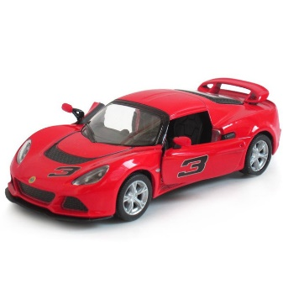

High Level Architecture
User Profile
Driver personalized settings:
Seat position
Radio station
AC
Mirrors
Others
Natural Language Engine
powered by Microsoft
Cognitive Services
User Profile Unit
LUIS
Language Understanding Intelligent Service
Windows 10 App
powered by
Surface Pro 4
Voice
Commands
mic array
VIU
(Voice Interaction Unit)
Voice
Interaction
VCU
(Vehicle Control Unit)
User Interface
VDU
(Vehicle Display Unit)
JSON/REST/HTTP
Same app?
Speaker
Recognition
Windows 10 App
powered by
Surface Pro 4
Windows 10
UWP App powered by
Surface Pro 4
Built-in maps support
Speaker Recognition API
JSON/REST/HTTP
Text to
Speech
SCU
(Sensors Control Unit)
Identify individual powered by
Speaker Recognition API
Cognitive Services
Leds, doors,trunk,
climatization, radio, seats, etc
Bing Speech API
Python Service
powered by raspberry 3
powered by Microsoft
Cognitive Services

Slide 2
Threads
Uses cases (all)
Text to Speech (herlander)
Natural Language and Control (herlander)
Dashboard (display unit) (???)
Sensors, Electronics and miniature car (Roger)
Sensors Control Unit (raspberry) (David)
Speaker Recognition and Speaker Location (Hugo)
User Profile and Personalization (Rui)
Pitch / Demo (Rui and All)

